Slide 1
Working code / software screenshots Iteration 2
Jackson Davis, Sanya Sinha, David Woolston

Slide 2
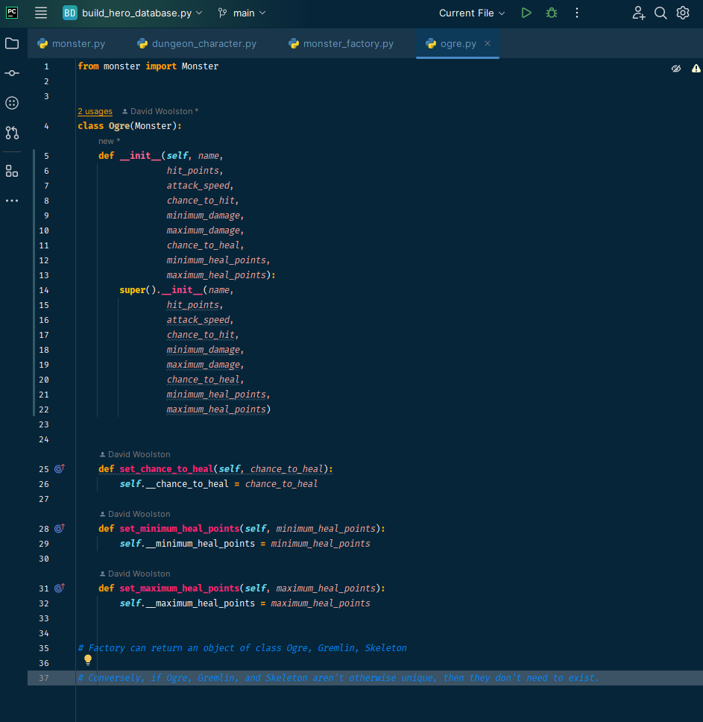
Ogre class code

Slide 3
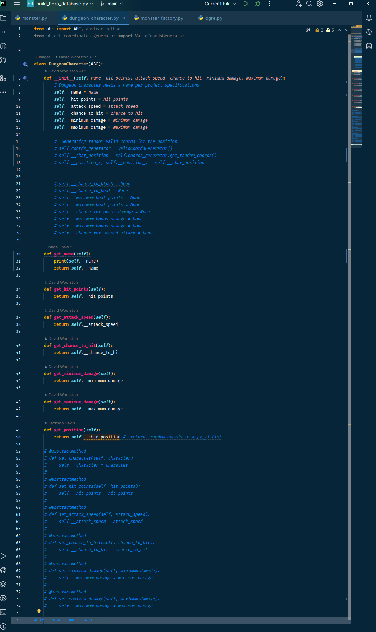
DungeonCharacter class code

Slide 4
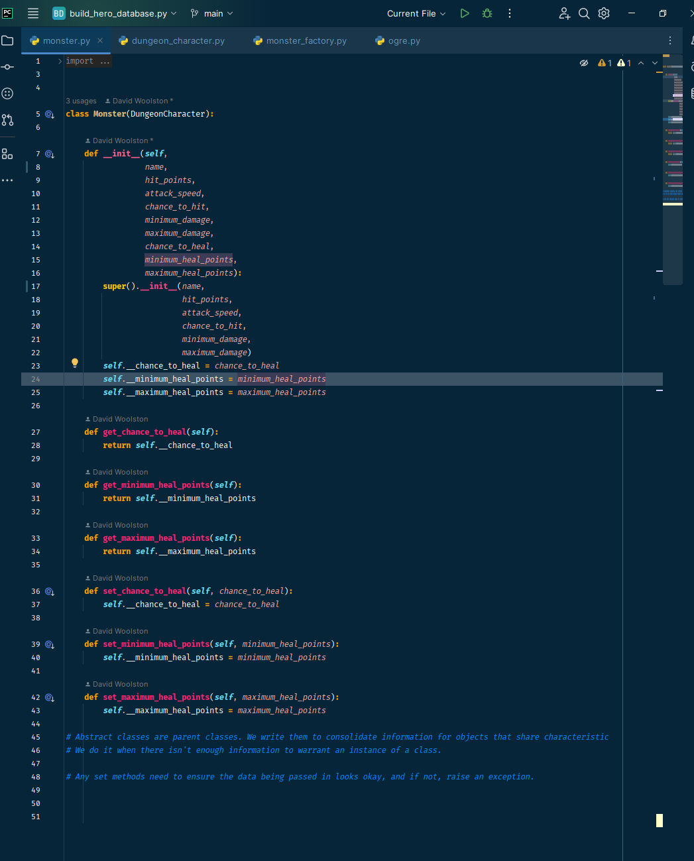
Monster class code

Slide 5
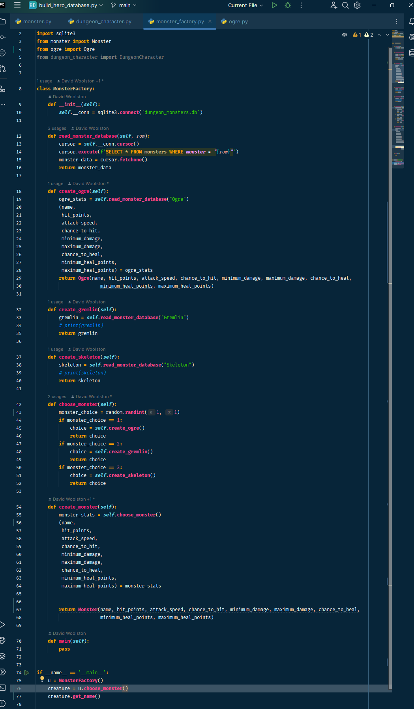
MonsterFactory code

Slide 6
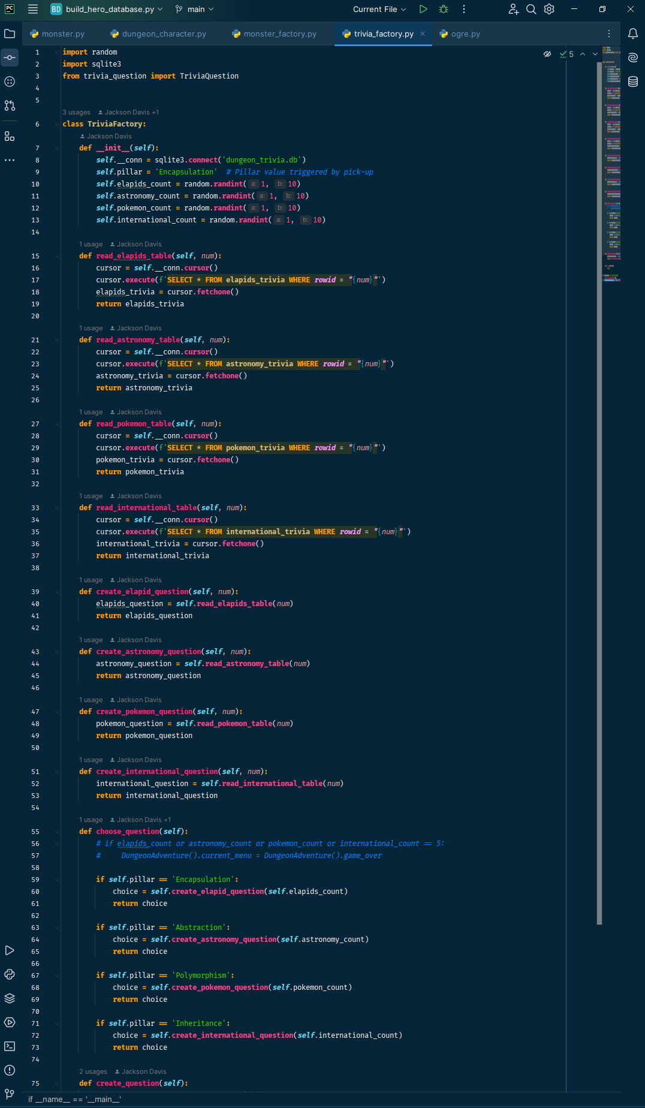
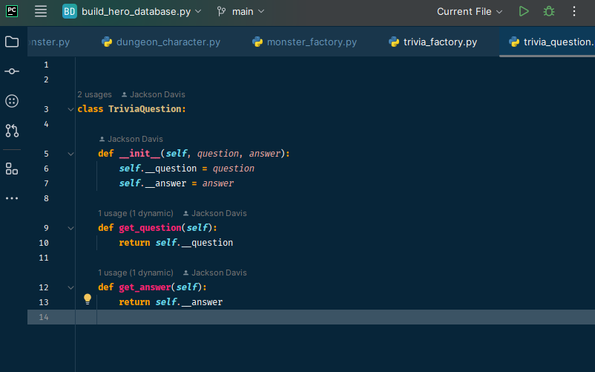
TriviaFactory code

Slide 7
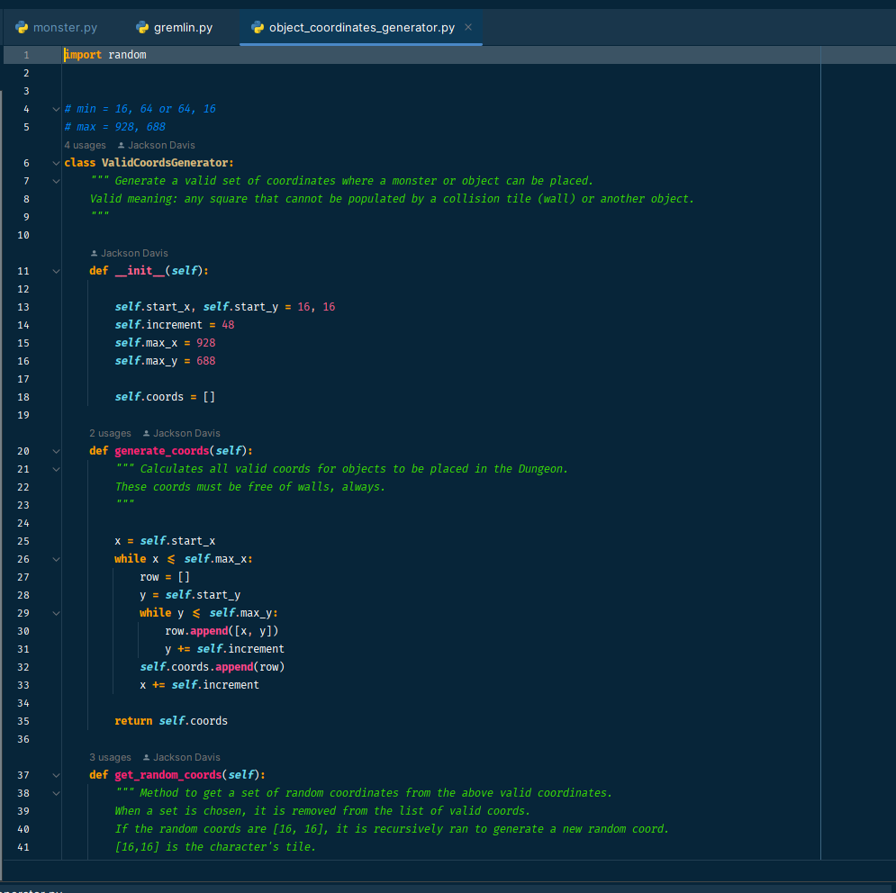
Coordinates generator to ensure objects are not placed on top of each other.

Slide 8
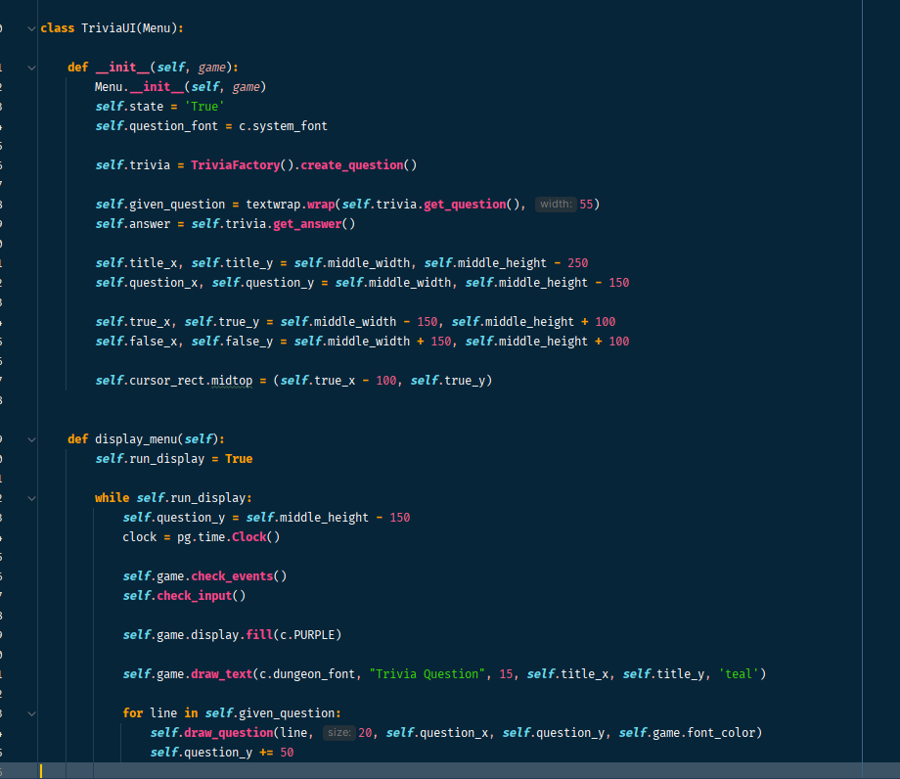
Trivia GUI to ensure multi-line questions are printed properly

